Slide 1
Intro to Package Management
Josh King

Slide 2

Who am I?
Josh King
ToastIT.dev
@windos@mastodon.nz
Infrastructure Ops Engineer @ Chocolatey

Slide 3

What’s a Package?
Like a physical package, it contains “stuff”
Could be software installer
Could be zip file to be extracted
Could be files (e.g. fonts)
Could be scripts that do… anything
Includes a manifest (like a packing slip) about the content
Photo by Brandable Box on Unsplash

Slide 4
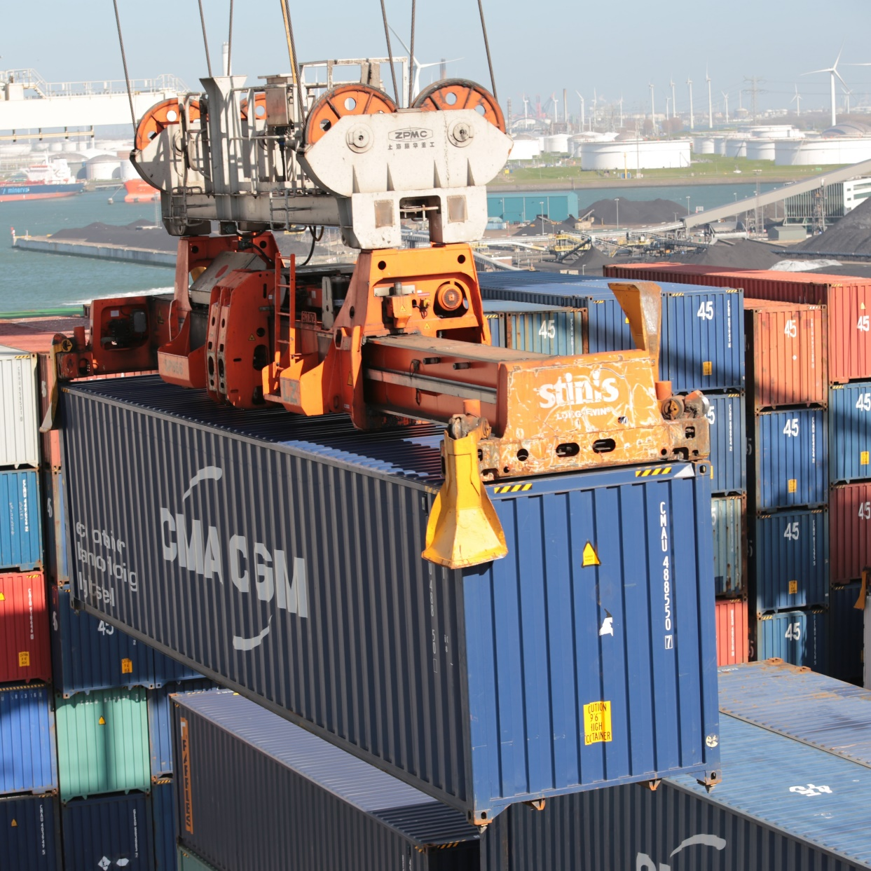
Why do Packages Need Managing?
Install, upgrade, and uninstall packages
List installed packages
Find available packages
Get information about a specific package
Some packages are useless without the support of other packages, you don’t want to manually untangle those dependencies
Photo by Bernd 📷 Dittrich on Unsplash

Slide 5
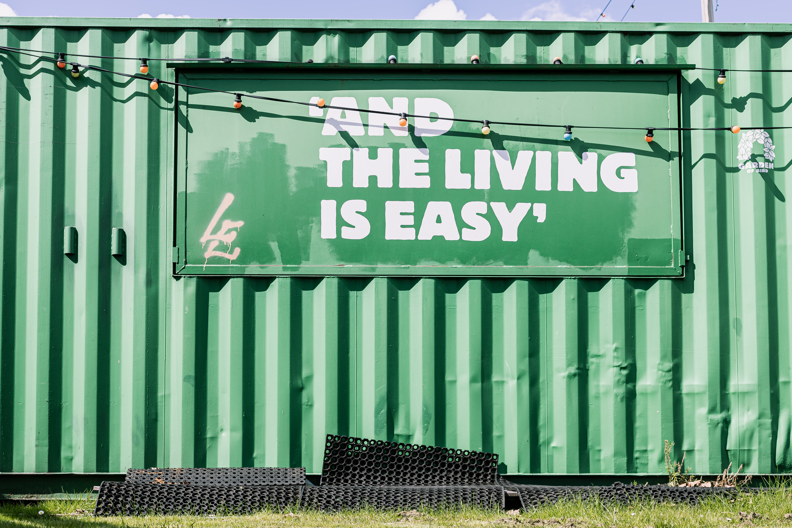
What Do You Get Out of It?
Need software? Install its package from the command line.
Automate it! Always want to be running up to date software, schedule checks for package upgrades.
Consistency across systems, install the same list of packages rather than running through a checklist of things to install.
Photo by micheile henderson on Unsplash

Slide 6


This is a Linux thing, right?
APT
DNF
YUM
PACMAN
HOMEBREW

Slide 7
Windows has Package Managers too!

Slide 8




And a surprising amount of them
Ninite … sort of
Scoop
Winget
Chocolatey

Slide 9
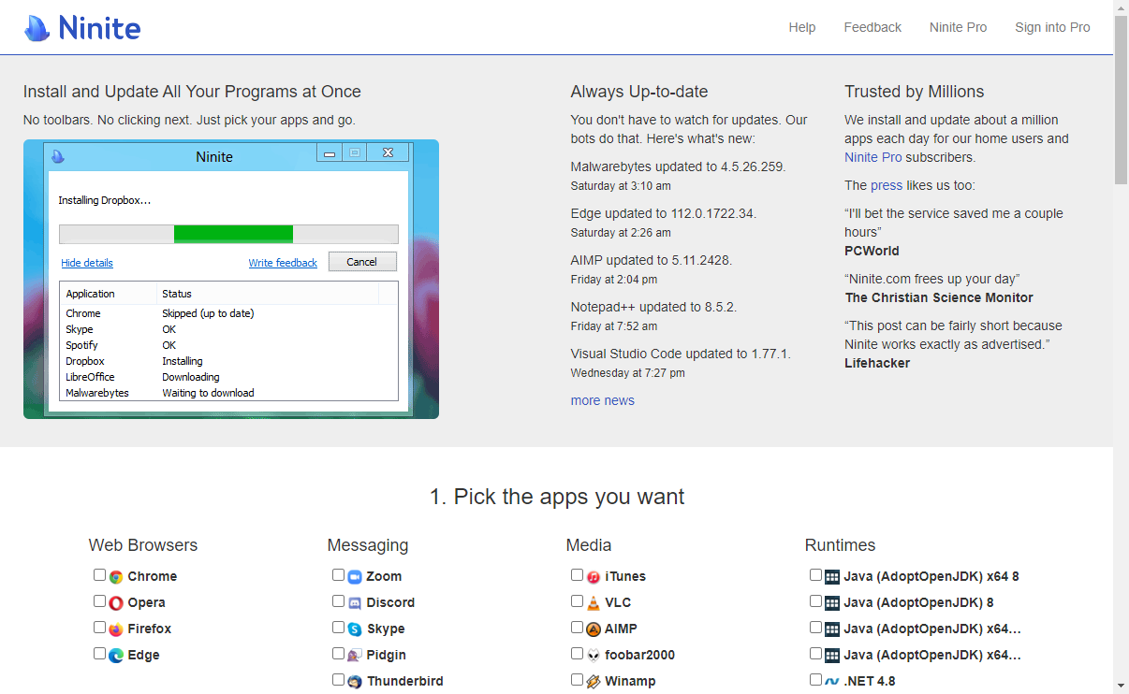
Ninite https://ninite.com

Slide 10
Scoop https://scoop.sh
Aims to enable software installs without administrative privileges
Installs packages to your home directory by default
Focuses on open-source developer tools
Over 5,000 packages available in the official “Buckets”

Slide 11
WINGET https://github.com/microsoft/winget-cli
Created by Microsoft
Also known as “Windows Package Manager”
Needs administrative privileges to install apps that need elevation
Will prompt via UAC is shell isn’t elevated
Requires the Microsoft Store, so Windows Server is not supported
Over 4,000 packages available from the Winget Community Repository

Slide 12
Chocolatey https://chocolatey.org
Has been around for 12 years
Requires administrative access
Has a commercial product for businesses
Integrates with other automation tools (like Ansible)
Almost 10,000 packages available on the Chocolatey Community Repository

Slide 13
DEMO

Slide 14
Key Takeaways
Packages != Software
… but they often do
We looked at managing packages on one system
Imagine how fast you could switch laptops by replicating the installed packages on the new one
Also consider how managing software installs and upgrades via packages could be leveraged across a fleet of computers
Creating packages is the next step
You’d do this for internal apps (e.g. RMM Agents or anything licensed specifically to your organization)
The method for creating packages differs per package manager, pick one and dig in!

Slide 15
Thank You! 💜
Get this slide deck and demo code from:
https://toast.click/OnRamp2023
Questions? Hit me up on Mastodon:
@windos@mastodon.nz

